Slide 1
Cleared Brain Snapshots Results
Keshav Shivam

Slide 2
Development Progress
Wrote a reusable script to batch crop and downsample images
Tested various size crops, dense, and sparse sections of the entire z stack
16 GB of RAM was not enough to run my algorithm on the entire z stack without cropping the image, Matlab threw memory errors
Crops no larger than 1/15-1/20 the size of the original image (in xy plane) were ideal
fibers = FiberFinder(depth, height, width, imgArray, 0.05, 4.5, 2, 13, 0); was used for each test

Slide 3
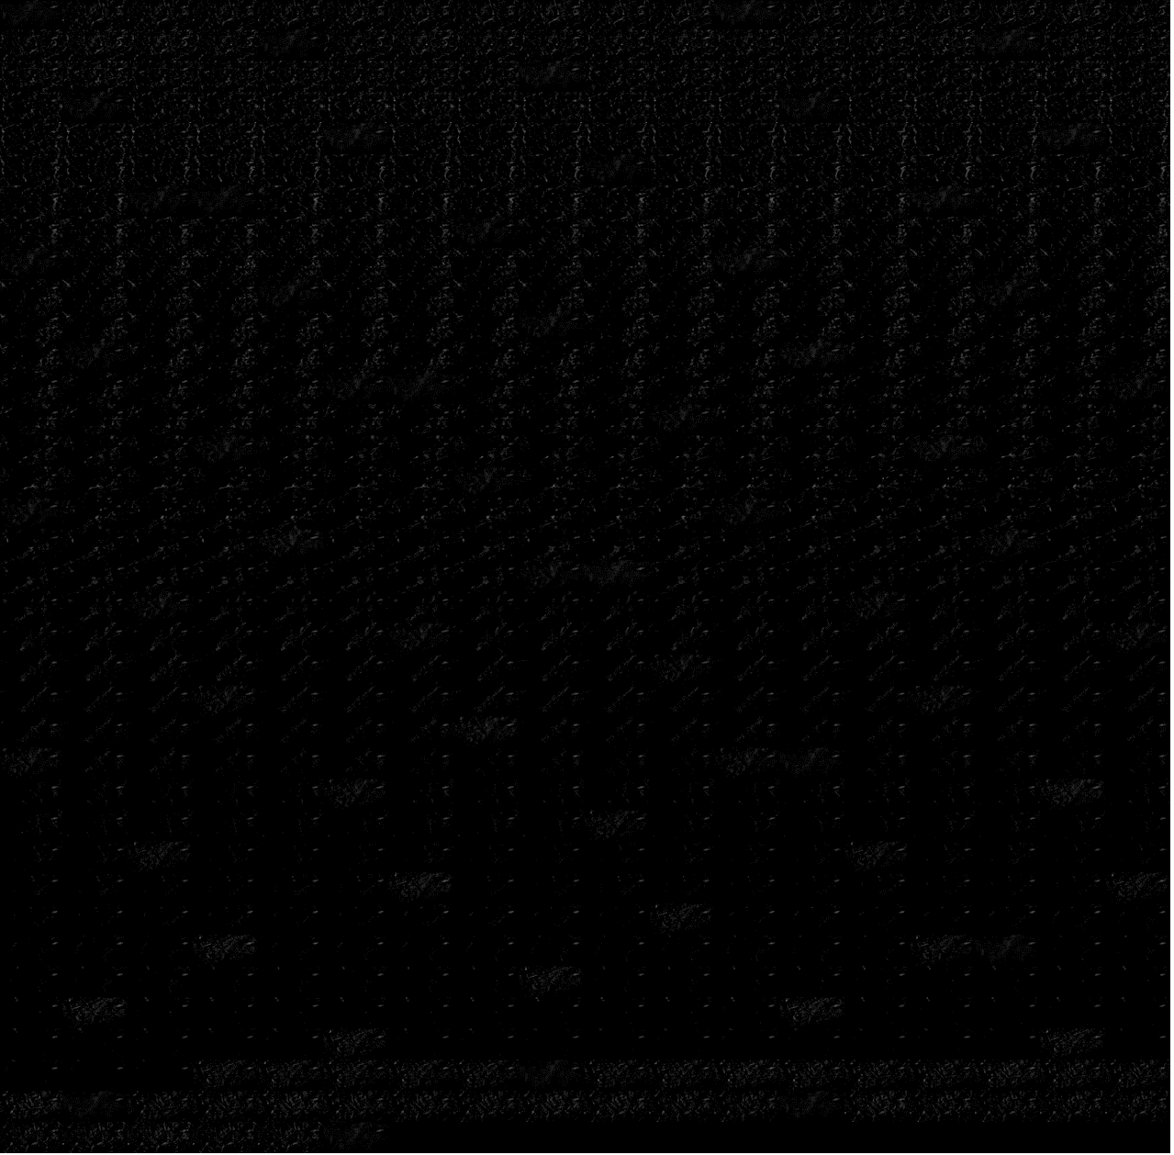
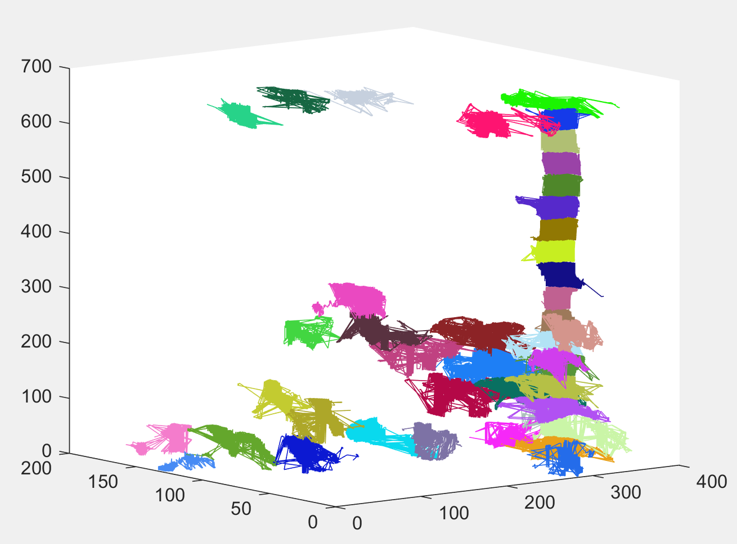
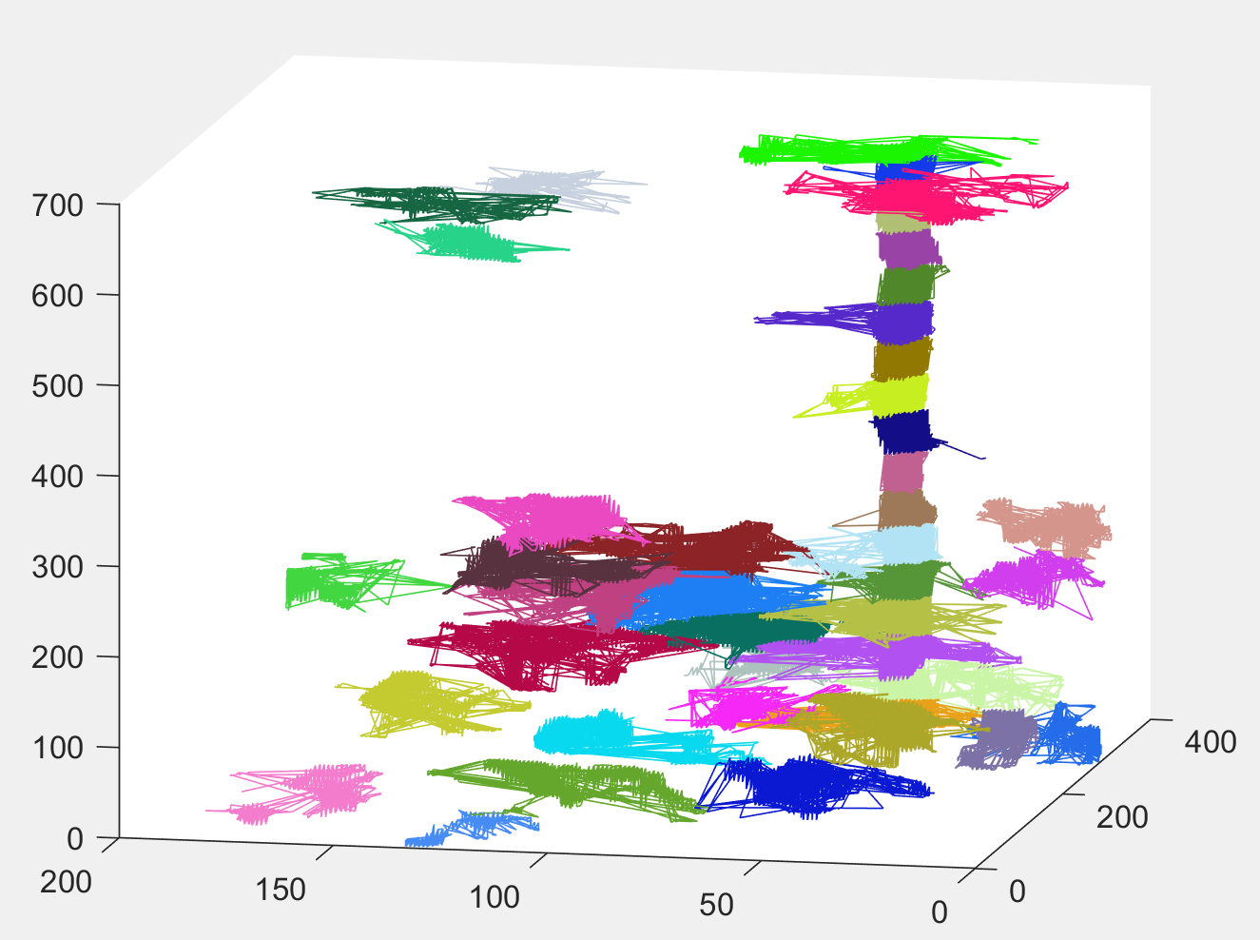
Small cropped brain region
Very small cropped region in xy direction-
Took ~1 hour to run
Long fiber identified as multiple fibers

Slide 4
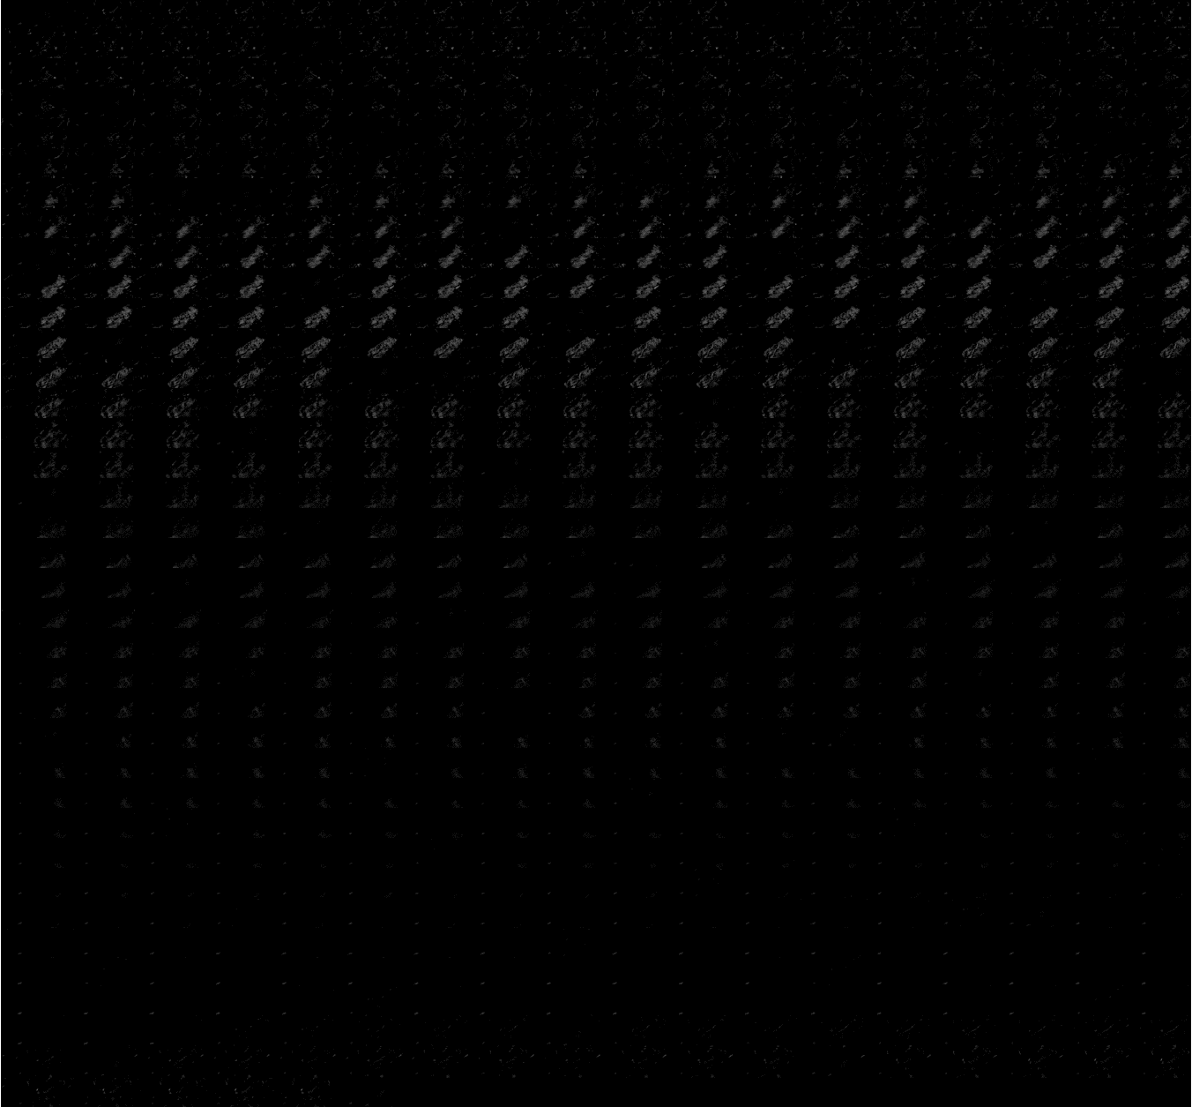
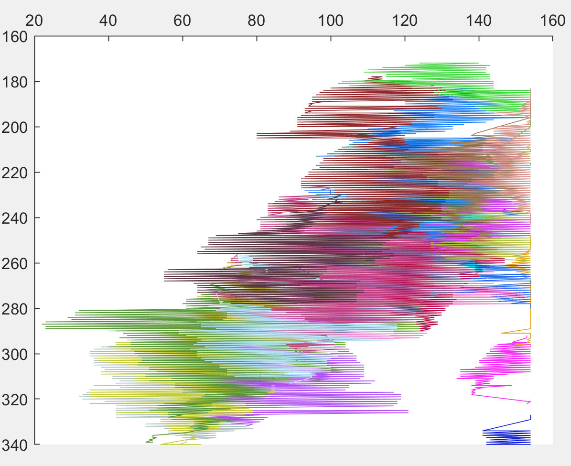
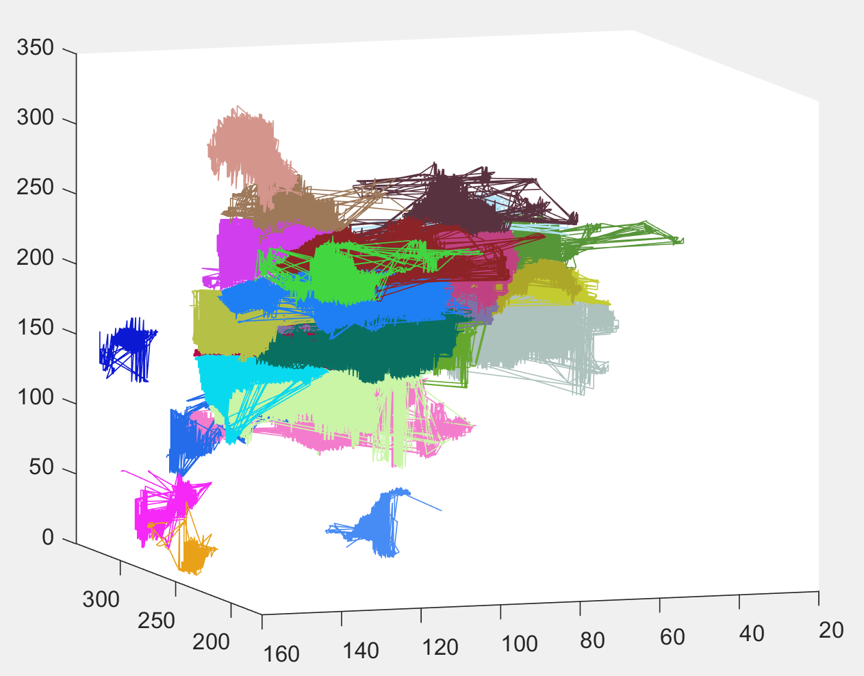
Small cropped brain region 2
Top view (middle) compares well with the montage (left)
Took ~28 min to run
Algorithm correctly segmented the larger image into smaller fibers, instead of one single fiber

Slide 5
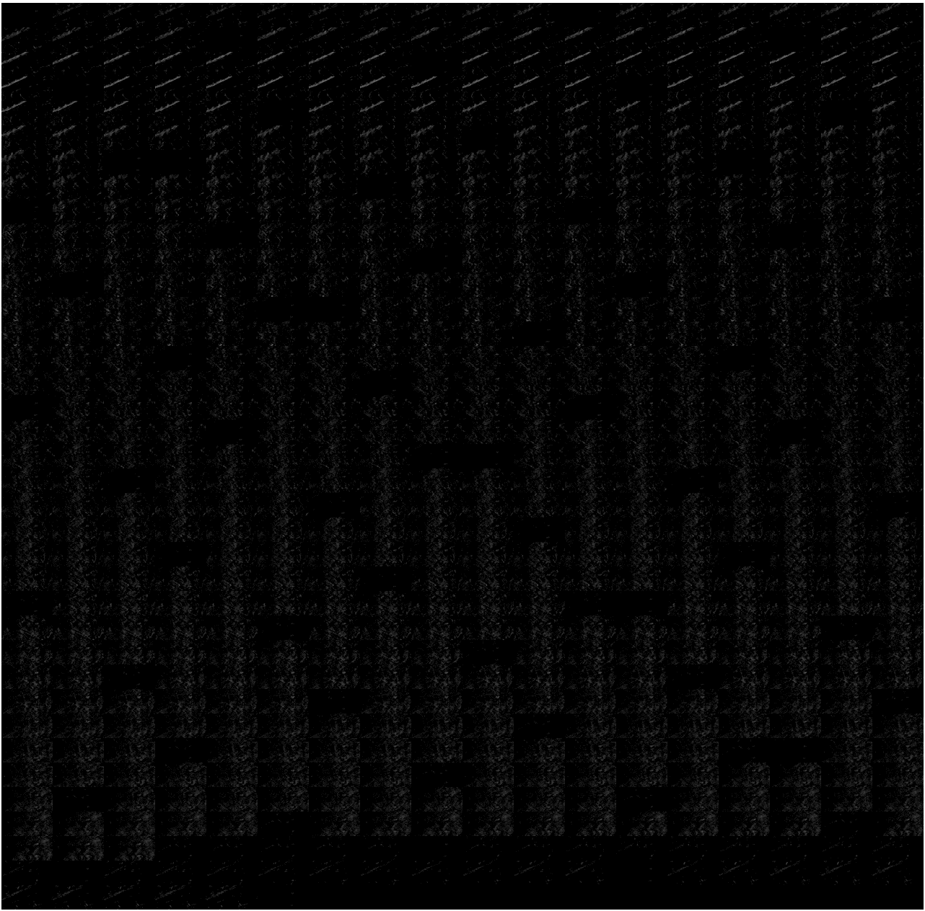
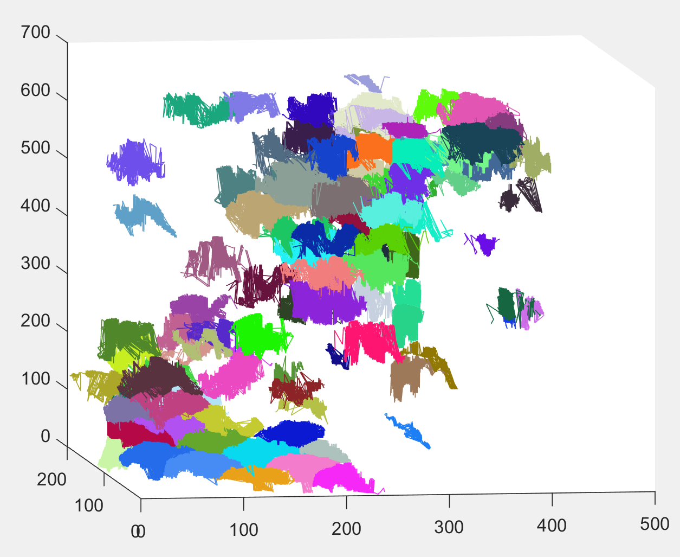
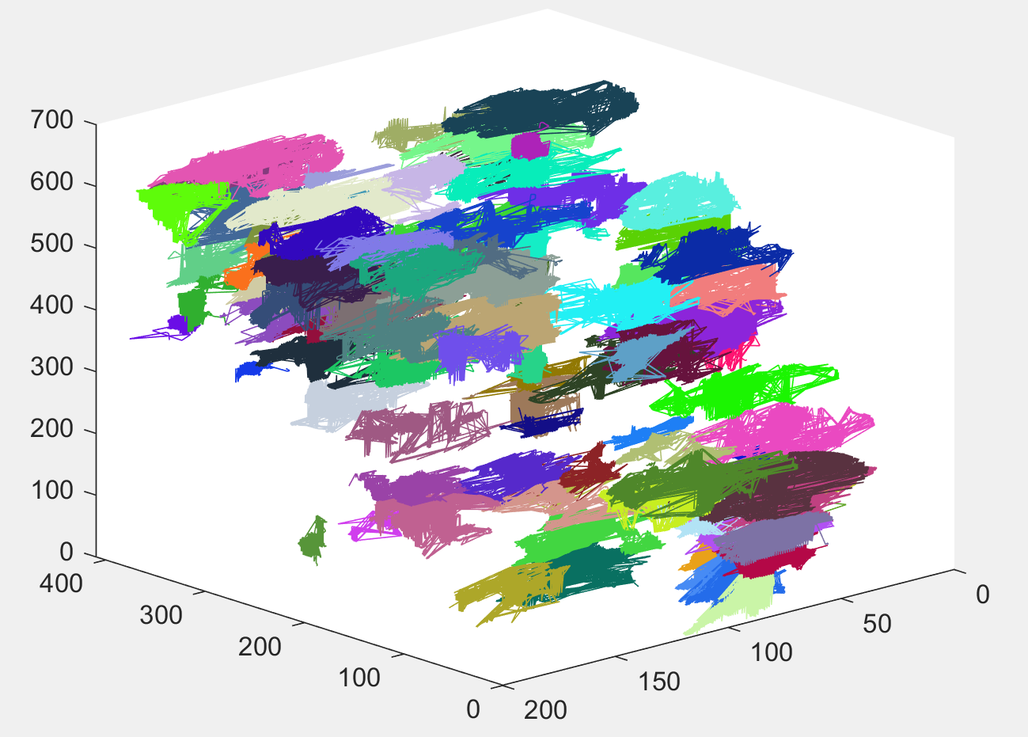
Small cropped brain region 3
Worked well with a dense image
Took ~3.5 hours to run

Slide 6
Testing various parameters
Problem: Longer fibers in dense images are segmented
Increased the maximum Depth First Search (DFS) limit from 5 to 7 and 10
Changed maximum fiber length to max(x, y, z) instead of avg(x, y, z)/10, where x, y, and z are the number of pixels in each direction of the stack
These changes allowed a long skinny fiber to be identified as less fibers, but also messed up the detection of smaller fibers
Will have to write code to join fibers that are contiguous

Slide 7
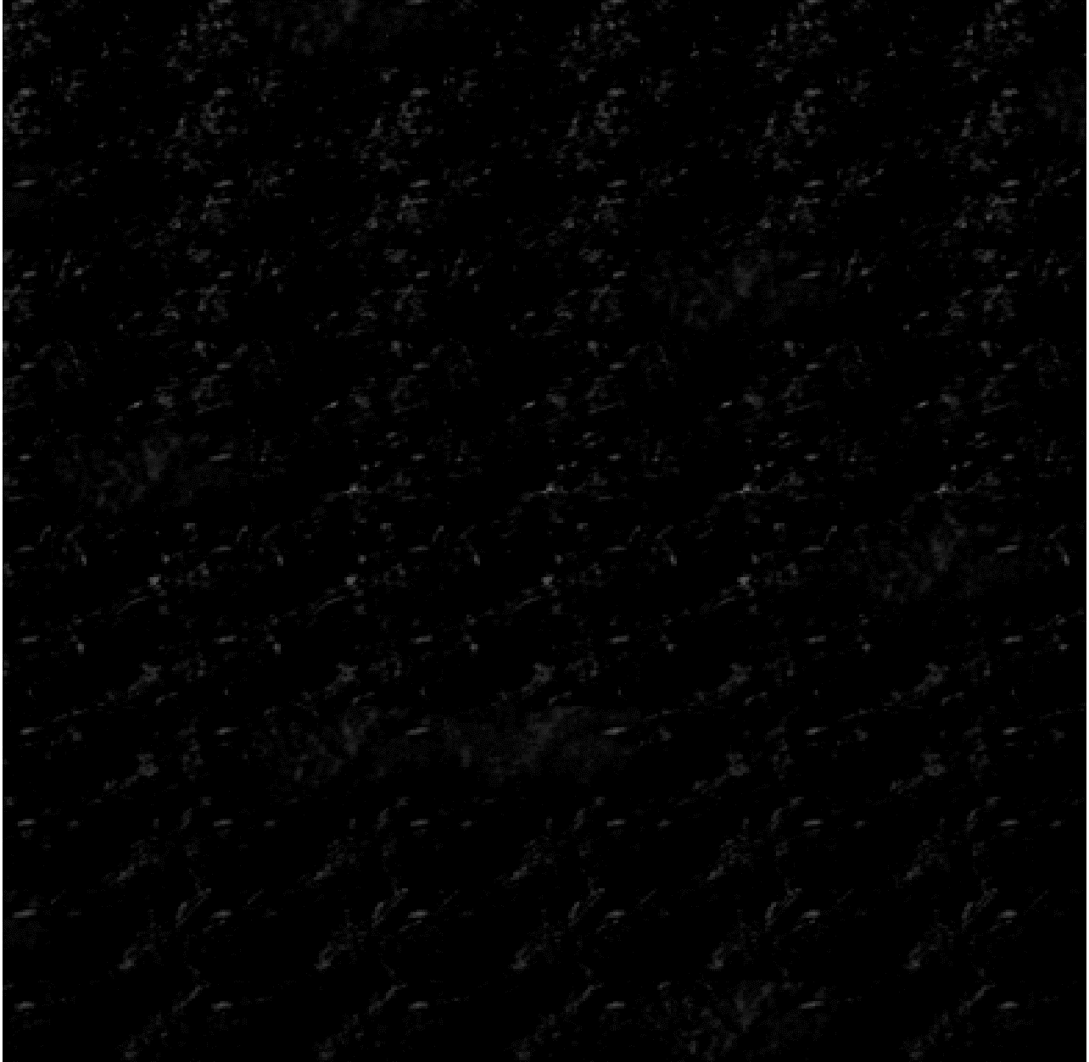
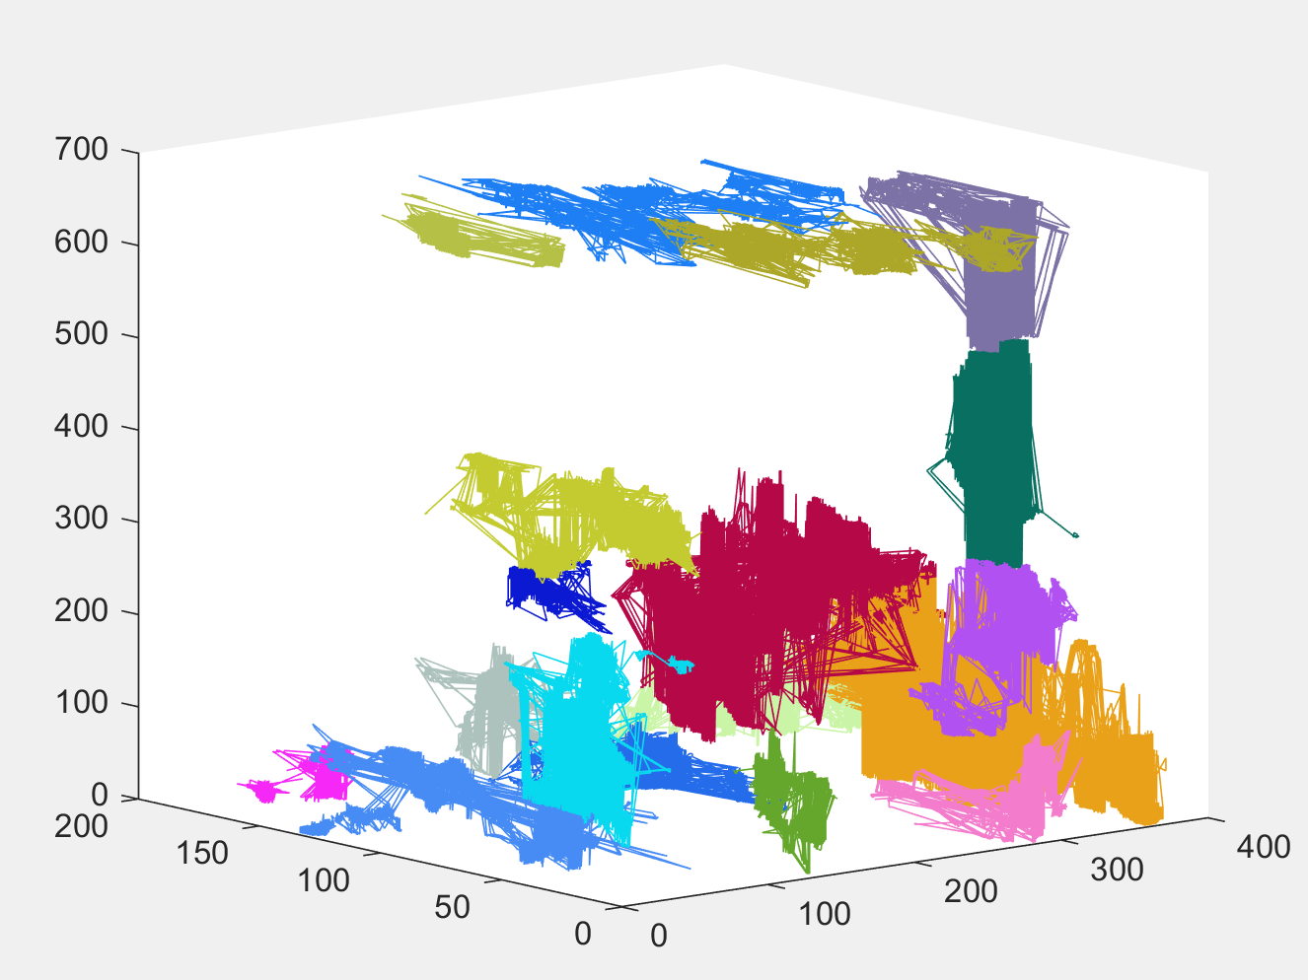
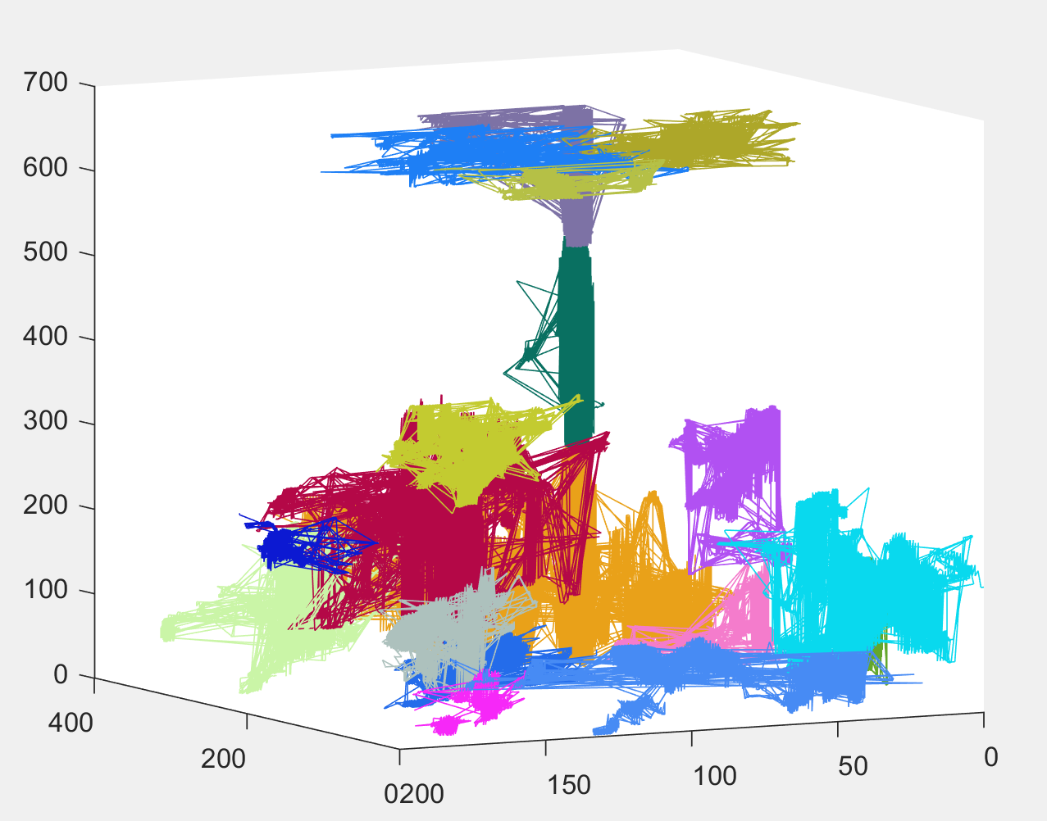
Small cropped brain region (testing)
Increased maximum fiber length to max(x, y, z) in number of pixels
Double DFS search depth limit to 10
Individual fibers are too wide and irregular
Took ~43 minutes, likely because more points were explored in one go

Slide 8

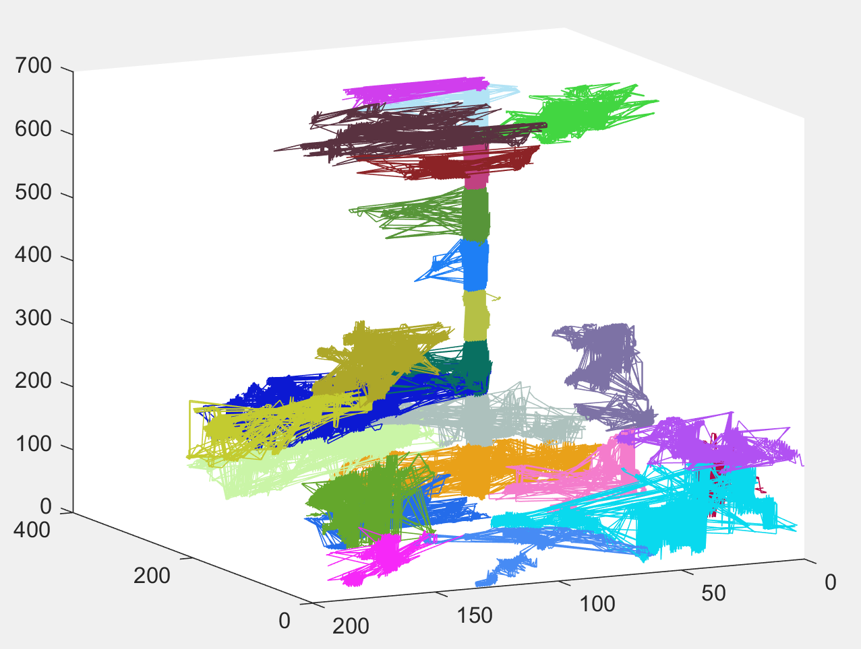
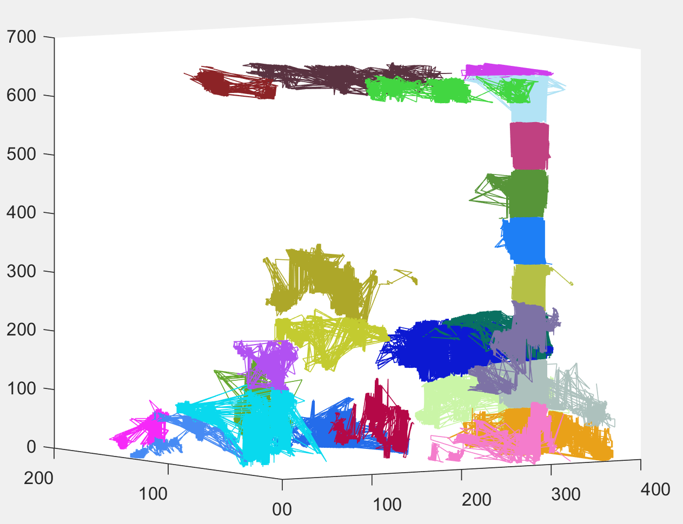
Small cropped brain region (testing)
Decreased DFS depth to 7
Took ~85 minutes
Original approach showed most clean results, need to write code to join contiguous fibers

Slide 9
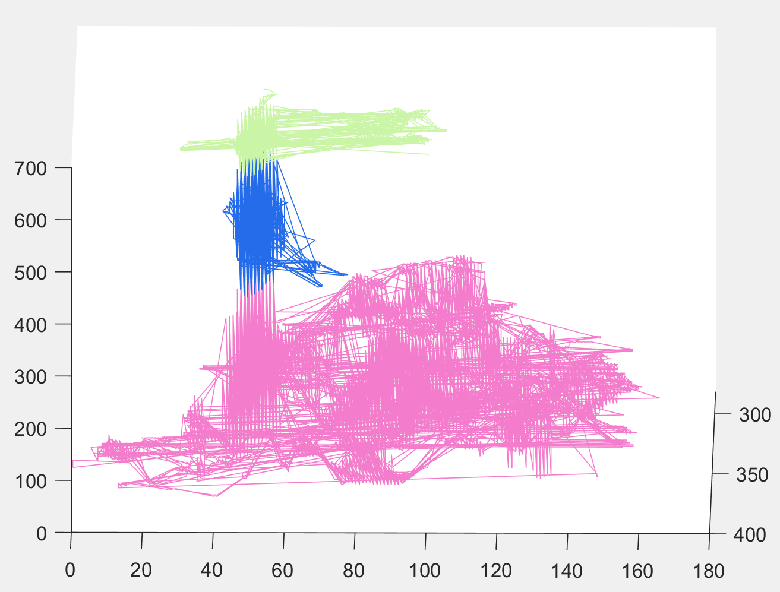
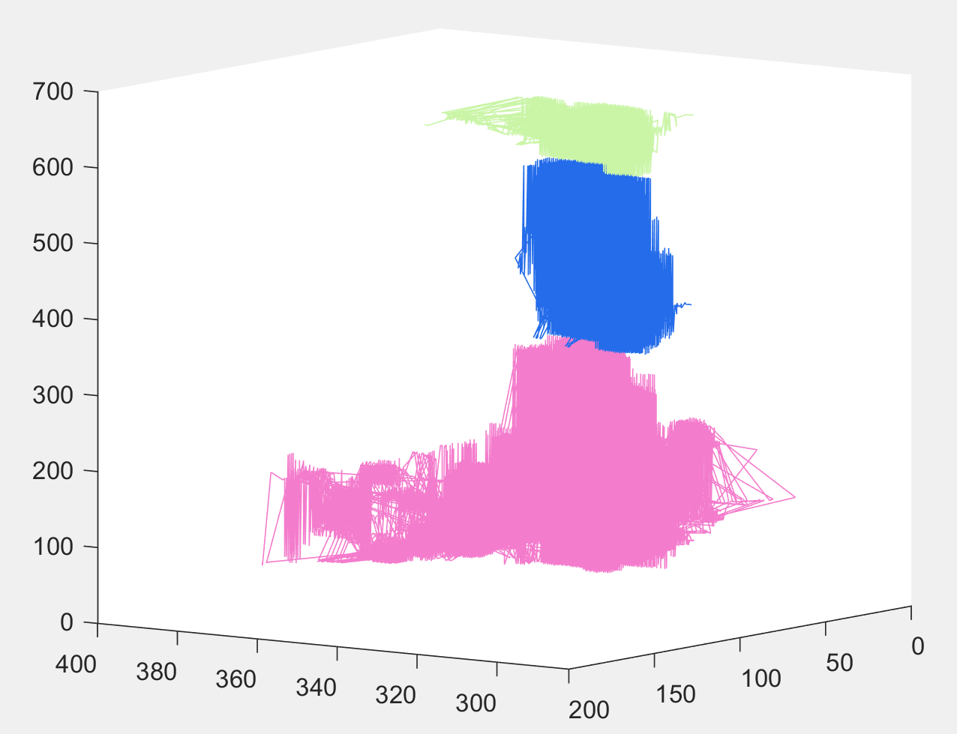
Small cropped brain region (testing)
DFS Depth = 7, increase max fiber length to avg(x,y,z)
Took 20 minutes

